Slide 2
Auto-Tune

Slide 3
Introduction

Slide 4
Introduction: Overview
Introduction
Overview
Inventor
The Patent
Reason for the invention
Previous attempts and shortcomings
Frequency domain approaches
Time domain approaches
System Overview
Detection
Tracking
Correction
Detection
Patent Implementation
My implementation
Tracking
Patent Implementation
My lack of implementation
Correction
Patent Implementation
My implementation
Demonstration of Implementation
Pure wave
Simple voice
Complex vocal signal

Slide 5
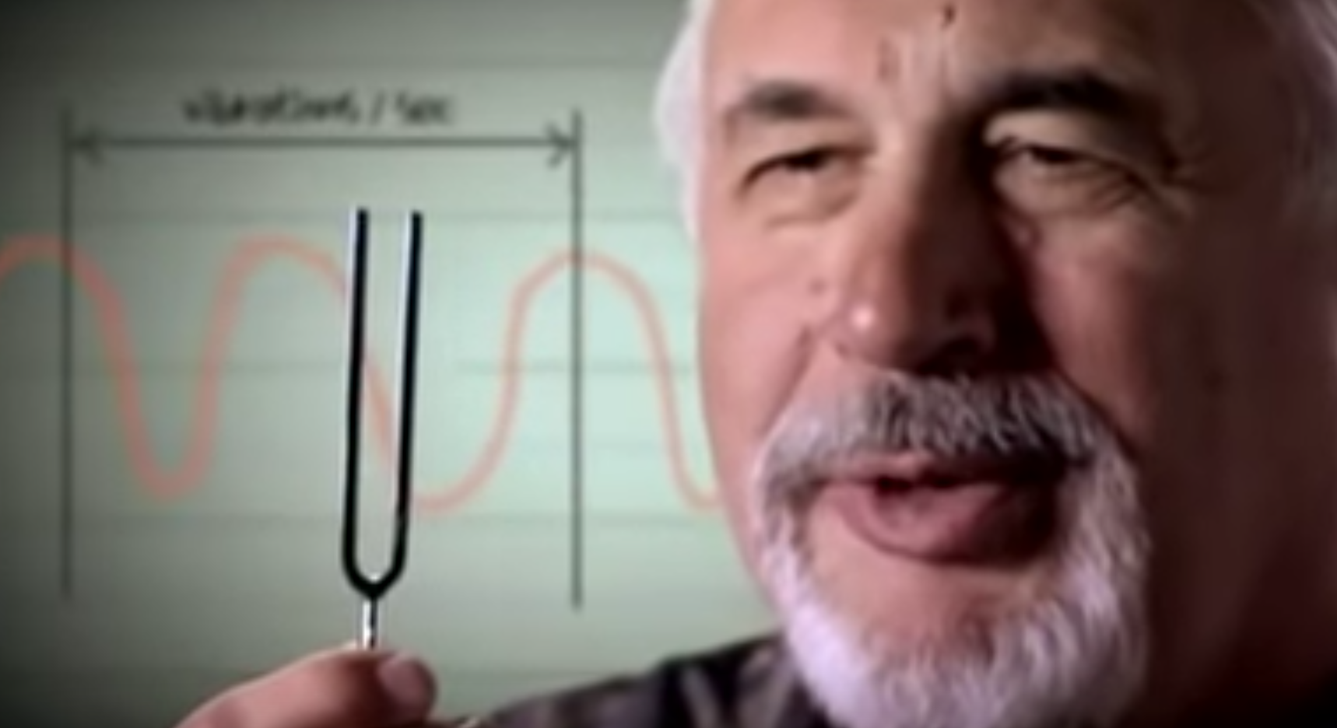
Harold Hildebrand
Electrical Engineer working for Exxon.
Applied digital signal processing knowledge to seismology.
Left the oil industry to apply the same techniques to his musical interests.
Invented Auto-Tune and founded Antares Audio Technologies

Slide 6
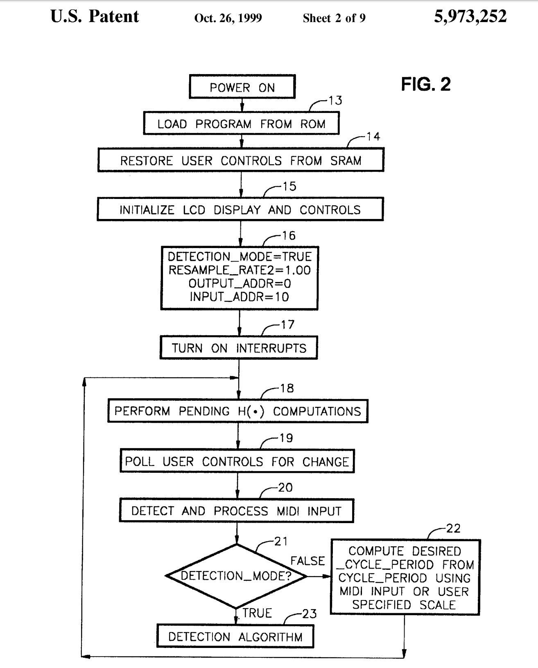
The Patent
Full system for real time pitch tracking and correction.
Microcontroller for processing.
Distinguishes itself from earlier inventions through the use of specific autocorrelation equations for pitch tracking.
Specifies wave resampling as the means for signal modification.

Slide 7
Reasons for the Invention
Allows for the modification of slightly off tune voice into tune with almost no distortion.
Allows for the introduction of synthetic vibrato.
The 90’s and the MTV age brought about the need to make visually appealing artists more acustically appealing.

Slide 8
Invention: Previous attempts and shortcomings
FFT overlap-and-save algorithms are not high quality algorithms for pitch shifting
They process sequences of data. Better quality pitch shifting occurs when longer sequences are used.
The entire sequence can be shifted only by a constant pitch change.
High quality intonation correction requires continuous changes in pitch.
Input data windowing and subsequent window overlap cross-fade computations are non-ideal operations that introduce distortions in the output.
Time domain approaches that worked around imprecise period knowledge, such as harmony generators, result in synthetic sounding voice.

Slide 9
System Overview

Slide 10
System Overview
Pitch Detection: Determining the the fundamental frequency of a signal at a given time point with no prior information about the signal.
Pitch Tracking: Determining the fundamental frequency of a signal at a given time point given the fundamental frequency of said signal at the previous time point.
Pitch Correction: The adjustment of a signals frequency spectrum so that the fundamental frequency of the signal is altered to a desired frequency, and all of the rest of the original signals frequency components are modified in a proportional way so as to not introduce distortion into the resulting signal.

Slide 11
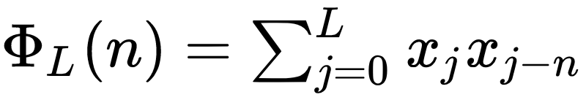
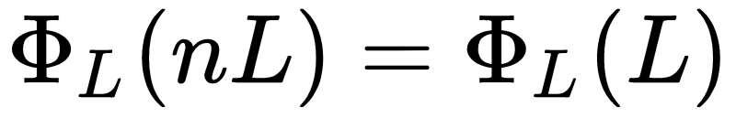
Pitch Detection
Autocorrelation
Given periodic signal x with period L, the autocorrelation a single

Slide 12
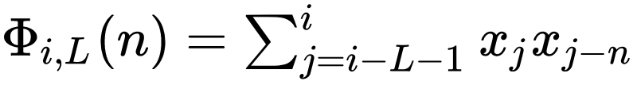
Pitch Detection
Autocorrelation
Let i be the most recent sample and L be the period of the wave.
Computationally expensive
Notes:
Add sin wave demo

Slide 13
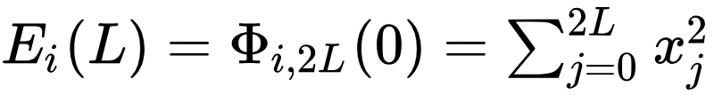
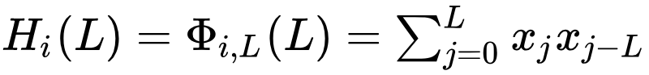
Pitch Detection
Given our autocorrelation at time i equation:
We derive two shortcut equations:

Slide 14
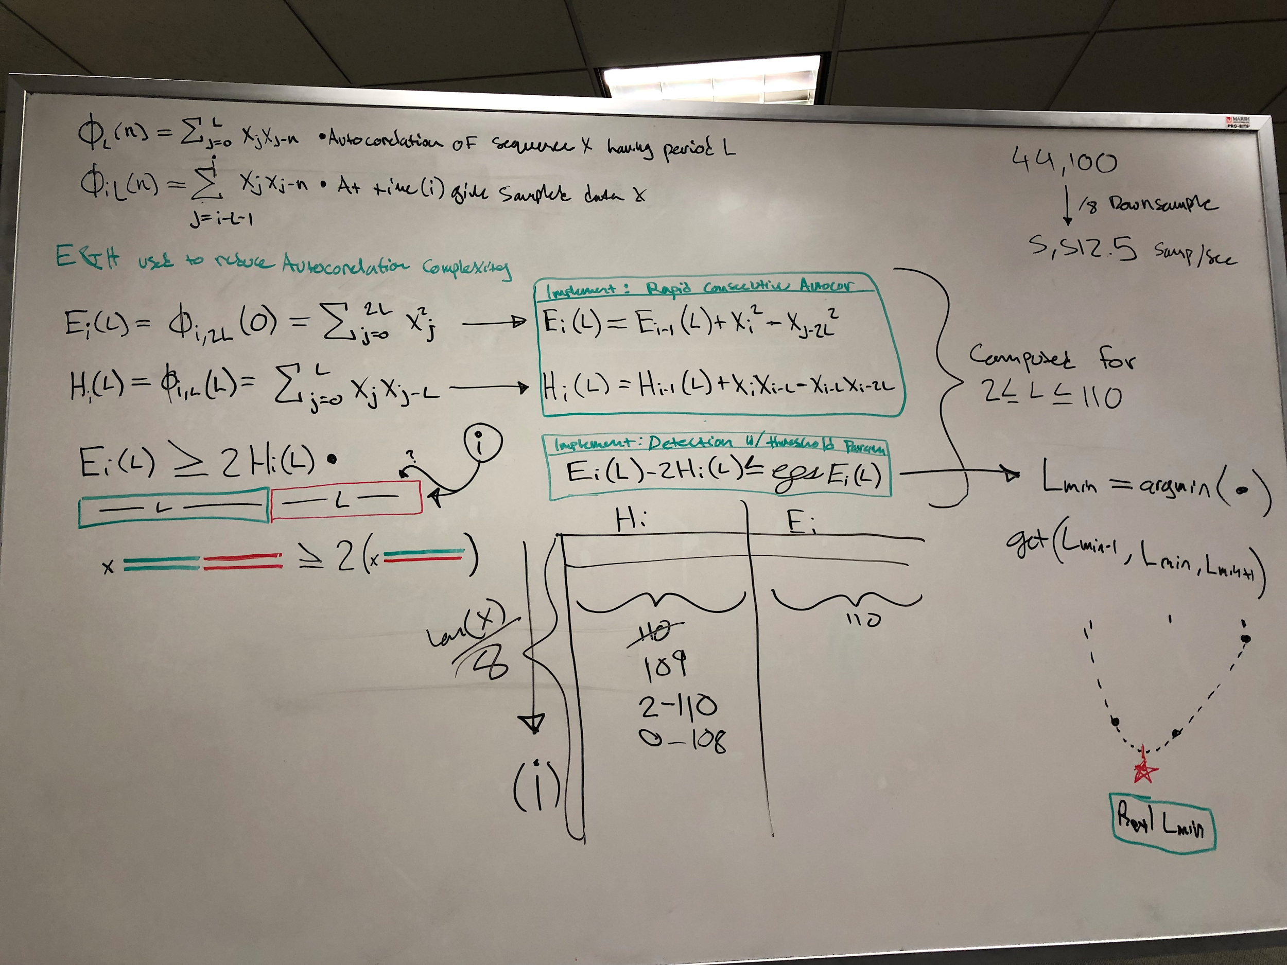

Slide 15
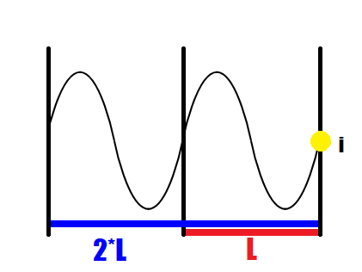

Slide 16
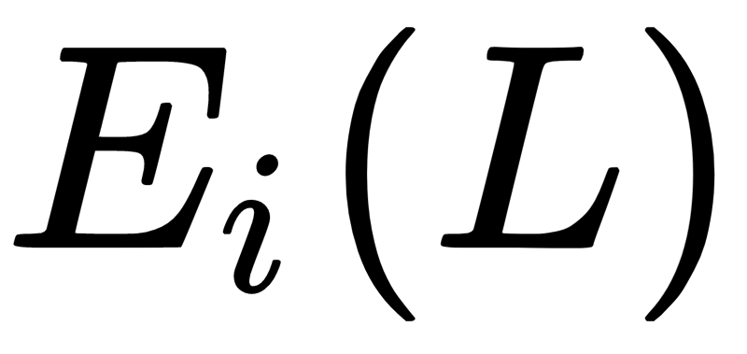
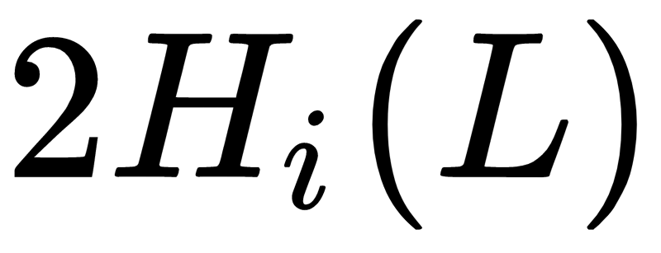
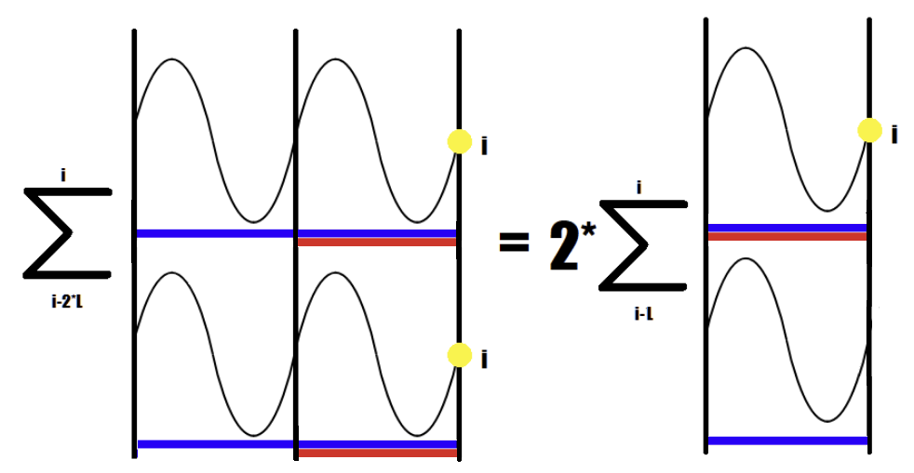

Slide 17
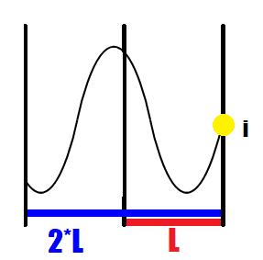

Slide 18
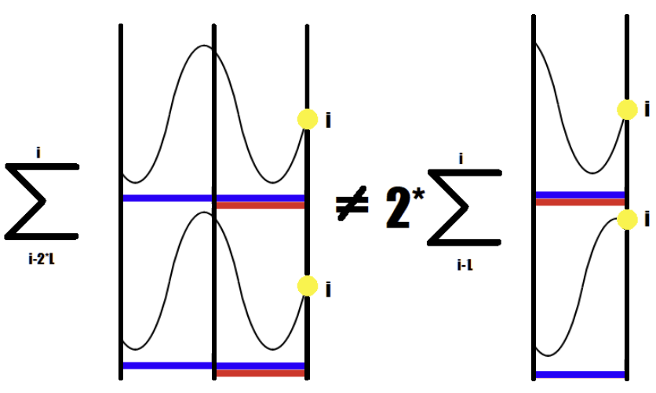

Slide 19
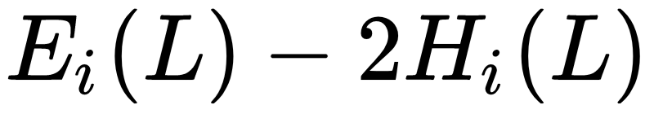
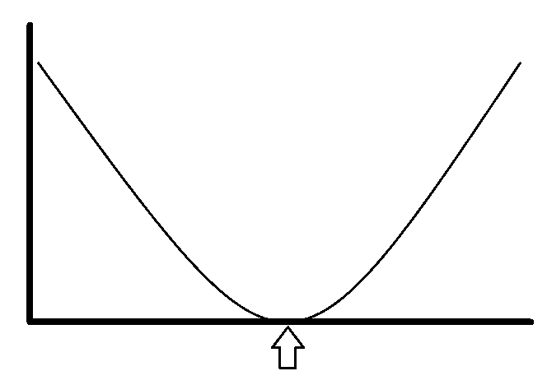
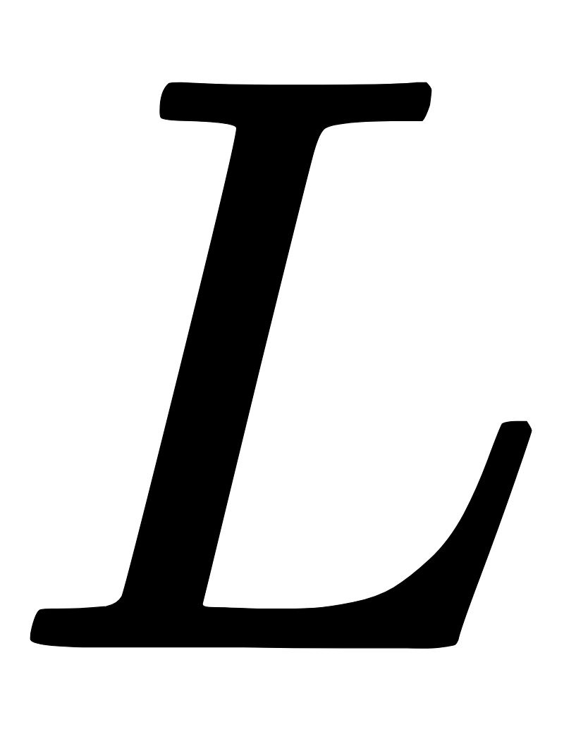
Interpolation over L points.
# boolean for period discovery
If E[L]-2*H[L] < sensitivity*E[L]:
Period = L
# sensitivity range (0,0.4]
Period of waveform

Slide 20
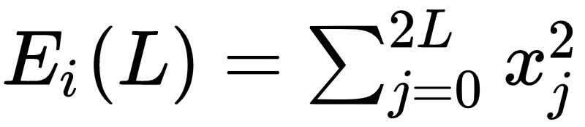
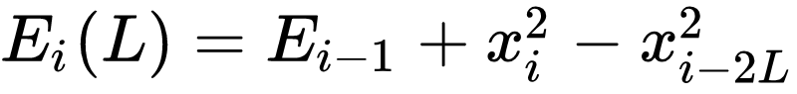
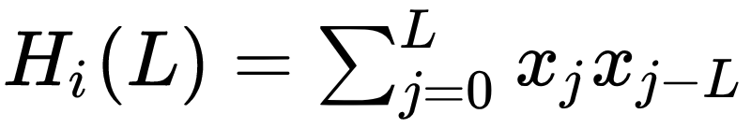
Improving Efficiency

Slide 21
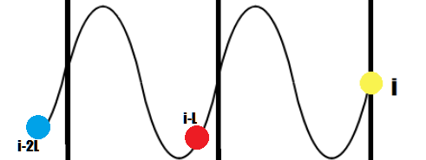
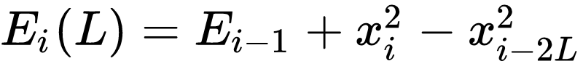
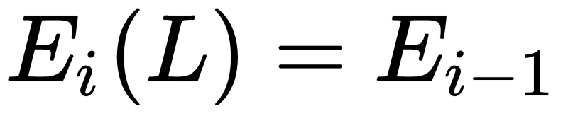

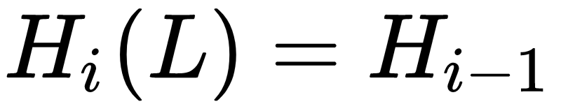

Improving Efficiency

Slide 22
Resampling (QUICKLY!)
Because we are looking at individual periods, resampling gets performed on the order of a period.
Signal is reassembled wave form by wavorm, each piece the size of one fundamental frequency.

